Slide 1










JavaFX
Computer Science Project I

Slide 2



Table of contents
Java GUI
Different ways to program GUIs in Java
Comparison of their characteristics
Scene Builder and JFoenix
MVC in JavaFx
Material we will use
© Copyright Universidad Europea. All rights reserved.
1

Slide 3


Java GUI
A GUI in Java is a visual interface that allows users to interact with an application graphically, rather than using the command line. Instead of typing text commands, users can use buttons, menus, text fields, and other visual elements to interact with the application.
© Copyright Universidad Europea. All rights reserved.
2

Slide 4
Different ways to program GUIs in Java
AWT (Abstract Window Toolkit)
Is an older library that is also part of the Java standard library.
Swing
Is a graphics library that has been part of the Java standard library since JDK 1.2.
SWT (Standard Widget Toolkit)
Is a toolkit for building graphical interfaces in Java using native operating system.
JavaFX
Is a platform for creating graphical user interface (GUI) applications in Java.
© Copyright Universidad Europea. All rights reserved.
3

Slide 5
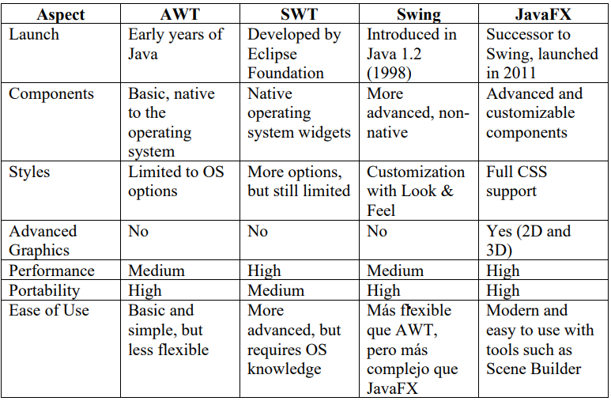
Comparison of their characteristics:
© Copyright Universidad Europea. All rights reserved.
4

Slide 6


Scene Builder
It is a graphical tool that simplifies the design of interfaces in JavaFX. It allows you to design user interfaces by dragging and dropping visual components, without the need to write code.
JFoenix
It is a component library for JavaFX that provides UI controls with a modern style.
JFoenix extends the standard JavaFX controls, adding new styles and functionality.
© Copyright Universidad Europea. All rights reserved.
5

Slide 7
MVC in JavaFx
Model
The model represents the application data and business logic. It should not have any
direct dependencies on the view or controller, thus allowing the business logic to be
kept separate from the user interface.
View
The view is responsible for displaying data to the user and providing user interface
controls. In JavaFX, you can build the view using JavaFX components in code or in
FXML files.
Controller
The controller handles the user interface logic and acts as an intermediary between the
model and the view. It responds to view events and updates the model as needed.
© Copyright Universidad Europea. All rights reserved.
6

Slide 8
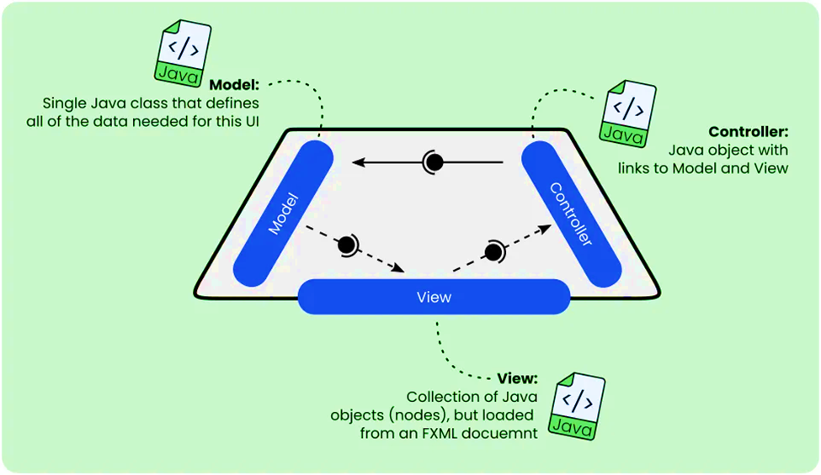
© Copyright Universidad Europea. All rights reserved.
7

Slide 9




Material we will use
- IJDK 17.0.1
- JavaFX SceneBuilder 22.0.0
- IntelliJ IDEA 2023.3.8
- JFoenix 9.0.0
- Plugin JavaFx
- Plugin JavaFx Runtime for plugins
© Copyright Universidad Europea. All rights reserved.
8

Slide 10
Let´s get fun !!
Practice: We are going to install the different tools from the guide, and we will practice doing the following exercises: hello world and login.
© Copyright Universidad Europea. All rights reserved.
9

Slide 11









 |  |  |  | THANKS | THANKS | THANKS | THANKS | THANKS | THANKS | THANKS
 |  |  |  | THANKS | THANKS | THANKS | THANKS | THANKS | THANKS | THANKS
 |  |  |  | THANKS | THANKS | THANKS | THANKS | THANKS | THANKS | THANKS
© Copyright Universidad Europea. All rights reserved.

